Slide 1
IoT Security
MO809 - Tópicos em Computação Distribuída
Luísa Madeira Cardoso

Slide 2
Topics
Today’s scenario
Why IoT Security is critical?
Attacks examples
Securing the Internet of Things
IoT Attack Surface areas
Guides

Slide 3





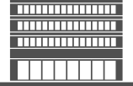

Why IoT Security is Critical?
Connecting physical things – can cause direct injury
Compromised devices could cost lives
Disasters
Accidents
Privacy Issues
Automated houses
Companies
Governments
Notes:
The IoT introduces a wide range of new security risks and challenges to the IoT devices themselves, their platforms and operating systems, their communications, and even the systems to which they're connected (such as using IoT devices as an attack channel). Creating smarter products often removes traditional architectural barriers; for example, critical car systems are now exposed to mobile apps (see Note 1 for selected examples of recent IoT security flaws). Security technologies will be required to protect IoT devices and platforms from both information attacks and physical tampering, to encrypt their communications, and to address new challenges such as impersonating "things" or denial-of-sleep attacks that drain batteries. IoT security will be complicated by the fact that many "things" use simple processors and operating systems that may not support sophisticated security approaches.

Slide 4
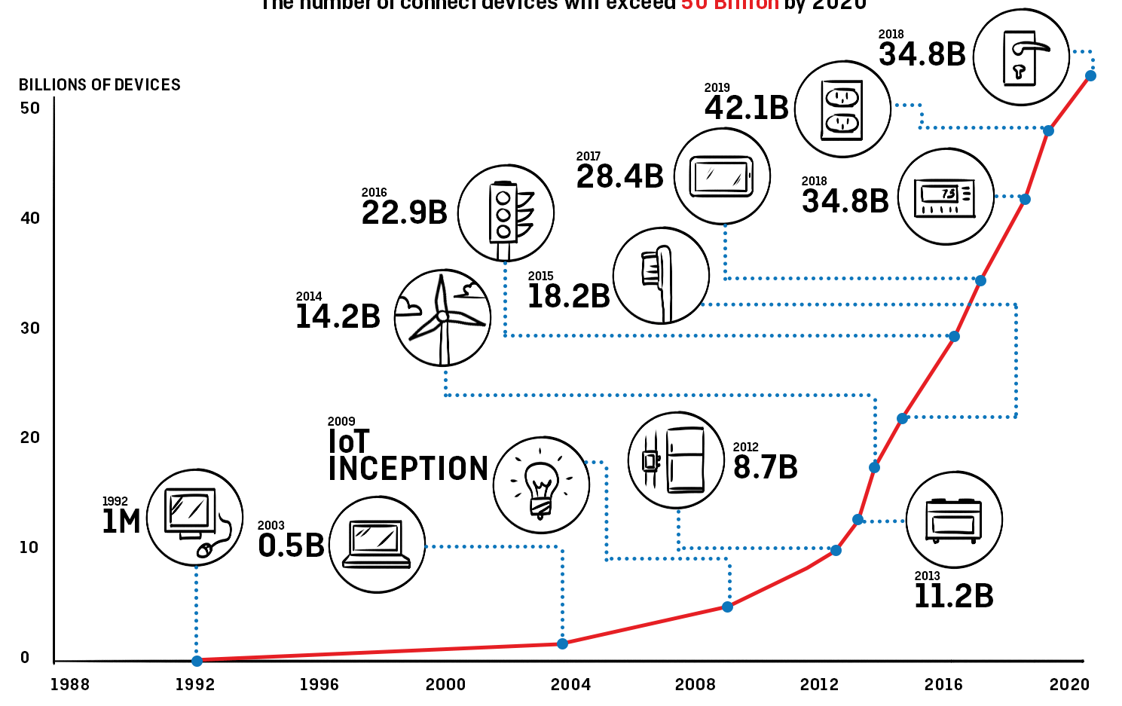
2020
25 billion (Gartner)
40 billion (ABI)
Source: National Cable & Telecommunications Association, Behind The Numbers: Growth In The Internet Of Things, 2015
Notes:
With more and more devices becoming connected, the attack surface for adversaries is target-rich

Slide 5
Science fiction?
A man had a NFC chip surgically implanted in his hand, which allowed him to load a malicious Web page into and subsequently control any Android phone he held. [Hackmiami 2015]
Changing the target of a Linux powered riffle [Black Hat 2015]
Hackers remotely kill a Jeep on the highway [Wired]
Notes:
https://www.iamthecavalry.org/domains/automotive/

Slide 6
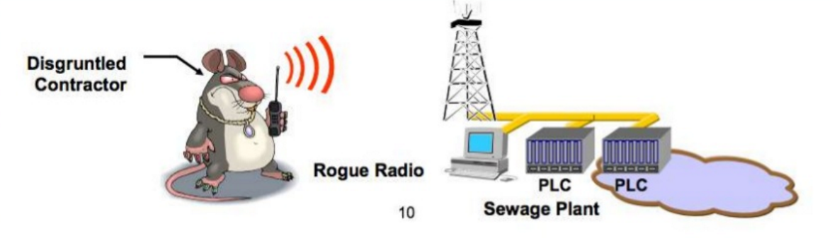
Science fiction?
In April 2000, a man took revenge of his previous employers: he attacked a Water treatment industry. Using a copy of the control system and a radio transmitter he caused the dump of 250 million tonnes of putrid sludge in the area’s rivers and parks. In the factory communications sent by radio links to wastewater pumping stations were being lost, pumps were not working properly, and alarms put in place to alert staff to faults were not going of. [RISI]
Notes:
RISI - The Repository of Industrial Security Incidents

Slide 7
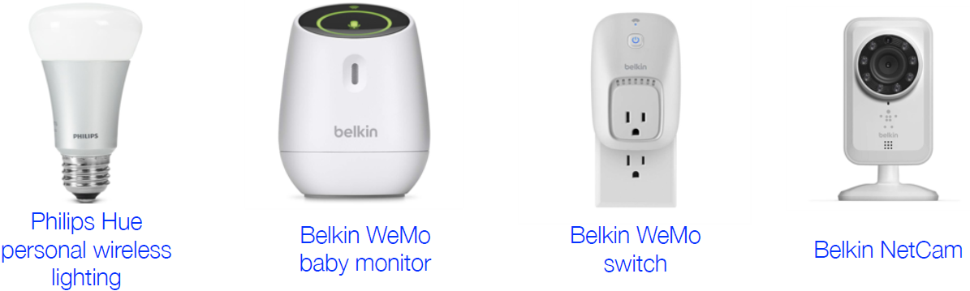
Too easy…
“Yes, we get it. Cars, boats, buses, and those singing fish plaques are all hackable and have no security. Most conferences these days have a whole track called ‘Junk I found around my house and how I am going to scare you by hacking it.’ That stuff is always going to be hackable whetherornotyouarethecalvalry.org.” [Dave Aitel’s rant]
https://www.iamthecavalry.org/domains/automotive/ - List of car attack reports in the media
Notes:
The Cavalry is a grassroots organization that is focused on issues where computer security intersect public safety and human life.
The areas of focus for The Cavalry are medical devices, automobiles, home electronics and public infrastructure.
Dave Aitel is a computer security professional. He joined the NSA as a research scientist aged 18 where he worked for six years before being employed as a consultant at @stake for three years.[1][2] In 2002 he founded a security software company, Immunity, where he is now the CTO

Slide 8
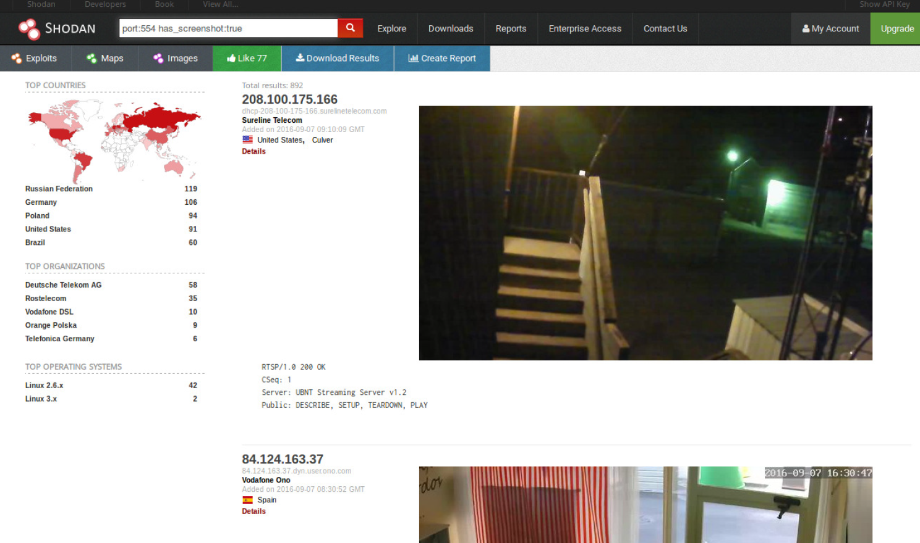
Notes:
https://www.shodan.io/
Search engine that lets the user find specific types of computers (web cams, routers, servers, etc.)
Service banners (meta-data the server sends back to the client)

Slide 9
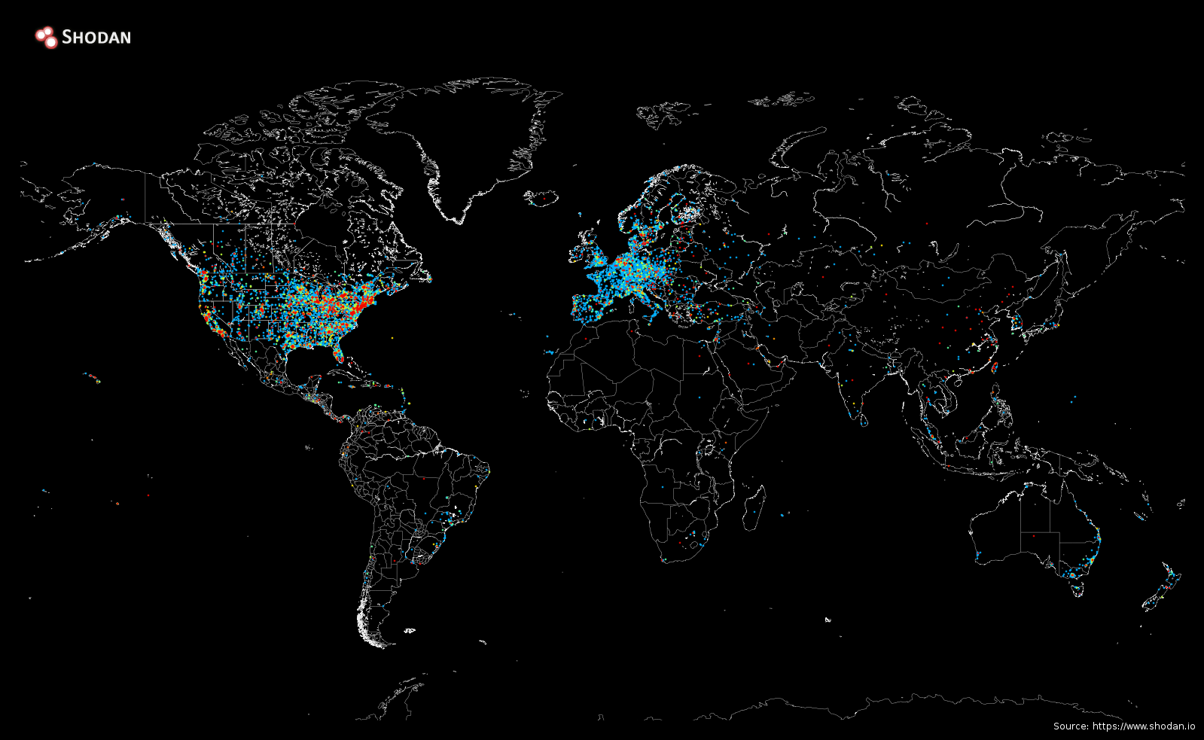
Map of Industrial Control Systems on the Internet
Notes:
https://icsmap.shodan.io/

Slide 10
Securing the Internet of Things

Slide 11
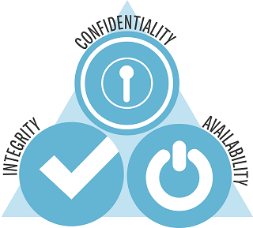
Security Goals
Notes:
Confidentiality - Is the property, that information is not made available or disclosed to unauthorized individuals, entities, or processes
Integrity - Data integrity means maintaining and assuring the accuracy and completeness of data over its entire life-cycle
Availability - For any information system to serve its purpose, the information must be available when it is needed.

Slide 12
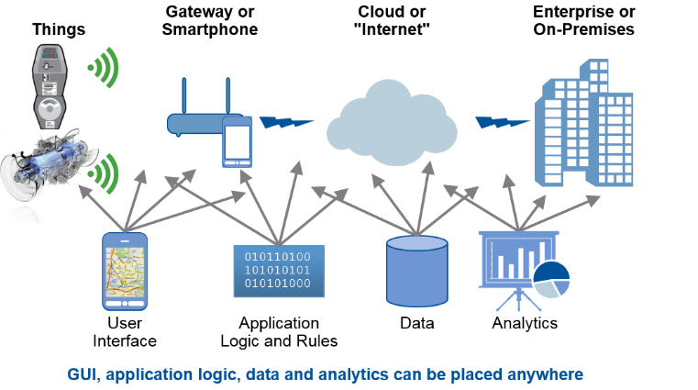
IoT Security != Device Security
Layers
Perception
Network
Middle-ware
Application

Slide 13
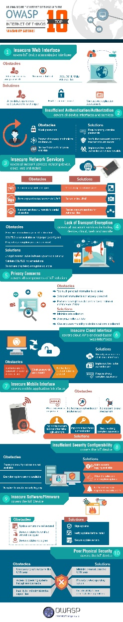
How to add security to the design
OWASP Internet of Things Project
Designed to help manufacturers, developers, and consumers better understand the security issues associated with the Internet of Things, and to enable users in any context to make better security decisions when building, deploying, or assessing IoT technologies
Builditsecure.ly
IoT Security Foundation
Notes:
OWASP - Open Web Application Security Project

Slide 14
IoT Attack Surface Areas
Ecosystem (general)
Ecosystem Access Control
Device Memory
Device Physical Interfaces
Device Web Interface
Device Firmware
Device Network Services
Administrative Interface
Local Data Storage
Cloud Web Interface
Third-party Backend APIs
Update Mechanism
Mobile Application
Vendor Backend APIs
Ecosystem Communication
Network Traffic
Authentication/Authorization
Privacy
Hardware (Sensors)

Slide 15
Device Layer
Unauthorized Access
Tag cloning
Local Data Storage
Unencrypted data
Data encrypted with discovered keys
Lack of data integrity checks
Device Memory
Cleartext usernames/passwords
Third-party credentials
Encryption keys
Device Physical Interface
Firmware extraction
User CLI / Admin CLI
Privilege escalation
Reset to insecure state
Removal of storage media
Tamper resistance
Debug port
Device ID/Serial number exposure

Slide 16
Device Layer
Device Web Interface
SQL injection
Cross-site scripting
Cross-site Request Forgery
Username enumeration
Weak passwords
Account lockout
Known default credentials
Device Firmware
Hardcoded credentials
Firmware version display and/or last update date
Backdoor accounts
Vulnerable services (web, ssh, tftp, etc.)
Security related function API exposure
Firmware downgrade
Device Network Services
User CLI / Administrative CLI
Injection
Denial of Service
Unencrypted Services
Poorly implemented encryption
Test/Development Services
Buffer Overflow
UPnP
Vulnerable UDP Services
DoS
Device Firmware OTA update block
Replay attack
Lack of payload verification
Lack of message integrity check

Slide 17
Device Layer
Can the software in the device be upgraded?
You can't secure it if you can't upgrade it!
If you can upgrade the firmware…
Must secure this channel.
If an attacker reflash the device…
Low cost sensors, batteries, weak processing power
Lightweight cryptography
Sleep deprivation attacks

Slide 18
Network layer
Jamming
Eavesdropping
Sniffing
Attacks
Sybil Attack
Single node pretends multiples identities. Problems can arise in a reputation system: the attacking node has a disproportionally large influence
Sinkhole Attack
Sleep depravation attack
DoS

Slide 19
Network layer
Jamming
Eavesdropping
Sniffing
Attacks
Sybil
Single node pretends multiples identities. Problems can arise in a reputation system: the attacking node has a disproportionally large influence
Sinkhole
Attacker makes the compromised node look attractive to the nearby nodes
Sleep depravation
Keeps the node awake, resulting in more battery consumption
DoS
Network is flooded with useless traffic or requisitions

Slide 20
Application Layer
Administrative Interface
Mobile Application
Web Application
Usual vulnerabilities
SQL injection
Cross-site scripting
Weak passwords
Account lockout
Known default credentials
Security/encryption
DoS
…

Slide 21
References
Twenty security considerationsfor cloud-supported Internet of Things
A Critical Analysis on the Security Concerns of Internet of Things
A Systemic Approach for IoT Security
OWASP
BuildItSecure.ly
Science Fiction and Ancient Warfare Can Teach Lessons on Security for the IoT
Securing the Internet of Things

